Slide 1
Missingness and Metrics
Are user ratings for schools helpful?

Slide 2
Introduction
Two Goals:
Is there a relationship between school user reviews and official school metrics?
Can we use natural language processing (NLP) to measure reviews?
Data Sources:
GreatSchools.org has expert and user reviews
Nj.gov has official test scores and other metrics
Used high schools in a 60 mile radius of Maplewood, NJ

Slide 3
Two Data Sources
NJ.gov
SAT Score
Dropout Rate
Graduation Rate
% College-bound
Greatschools.org
GS.org school Rating (“Expert Rating”)
User Reviews
User Ratings (”sentiment”)
Used scrapy for GS.org, Excel for NJ.gov
Manual cross-referencing

Slide 4
Part 1
Is there a relationship between school user reviews and official school metrics?

Slide 5
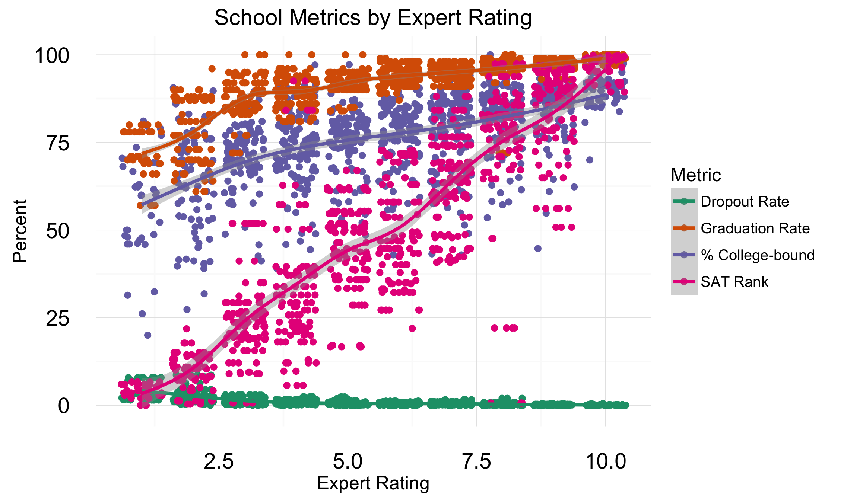
Expert Rating Relies Heavily Test Scores

Slide 6
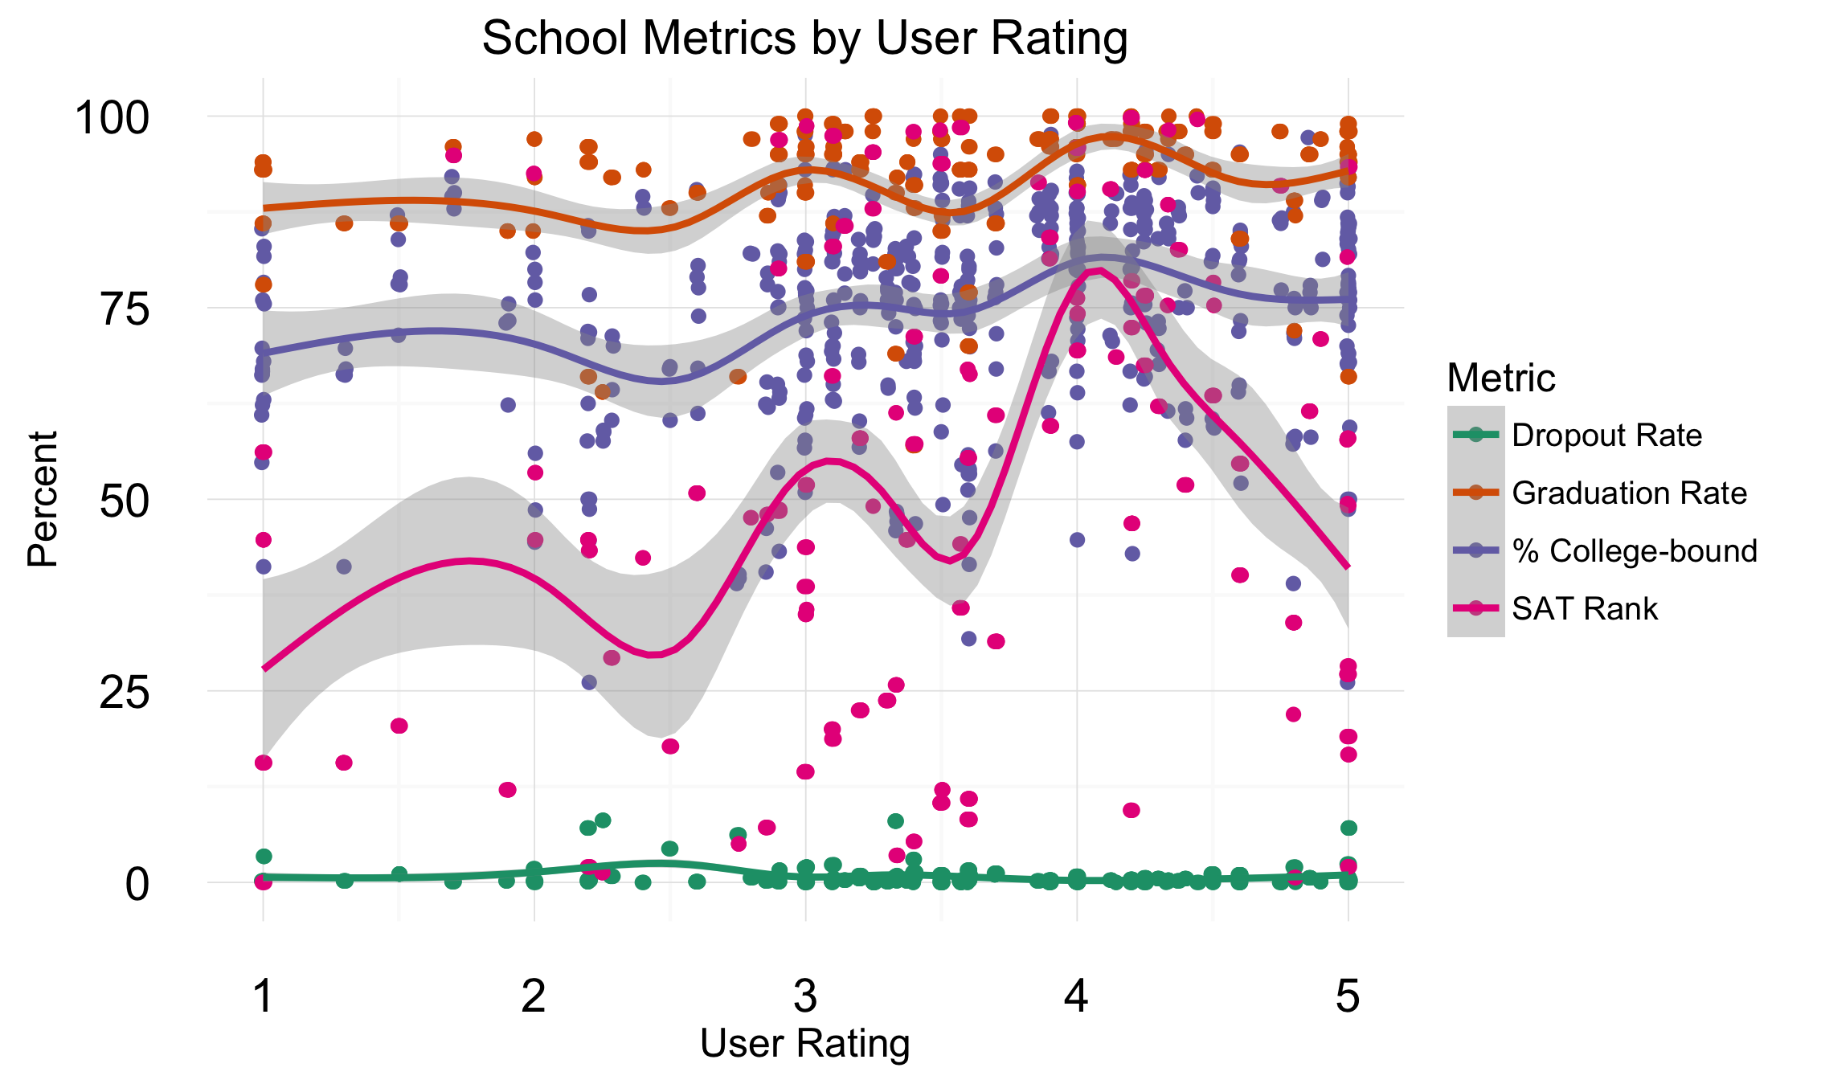
User Ratings Less Related to Measurable Outcomes

Slide 7
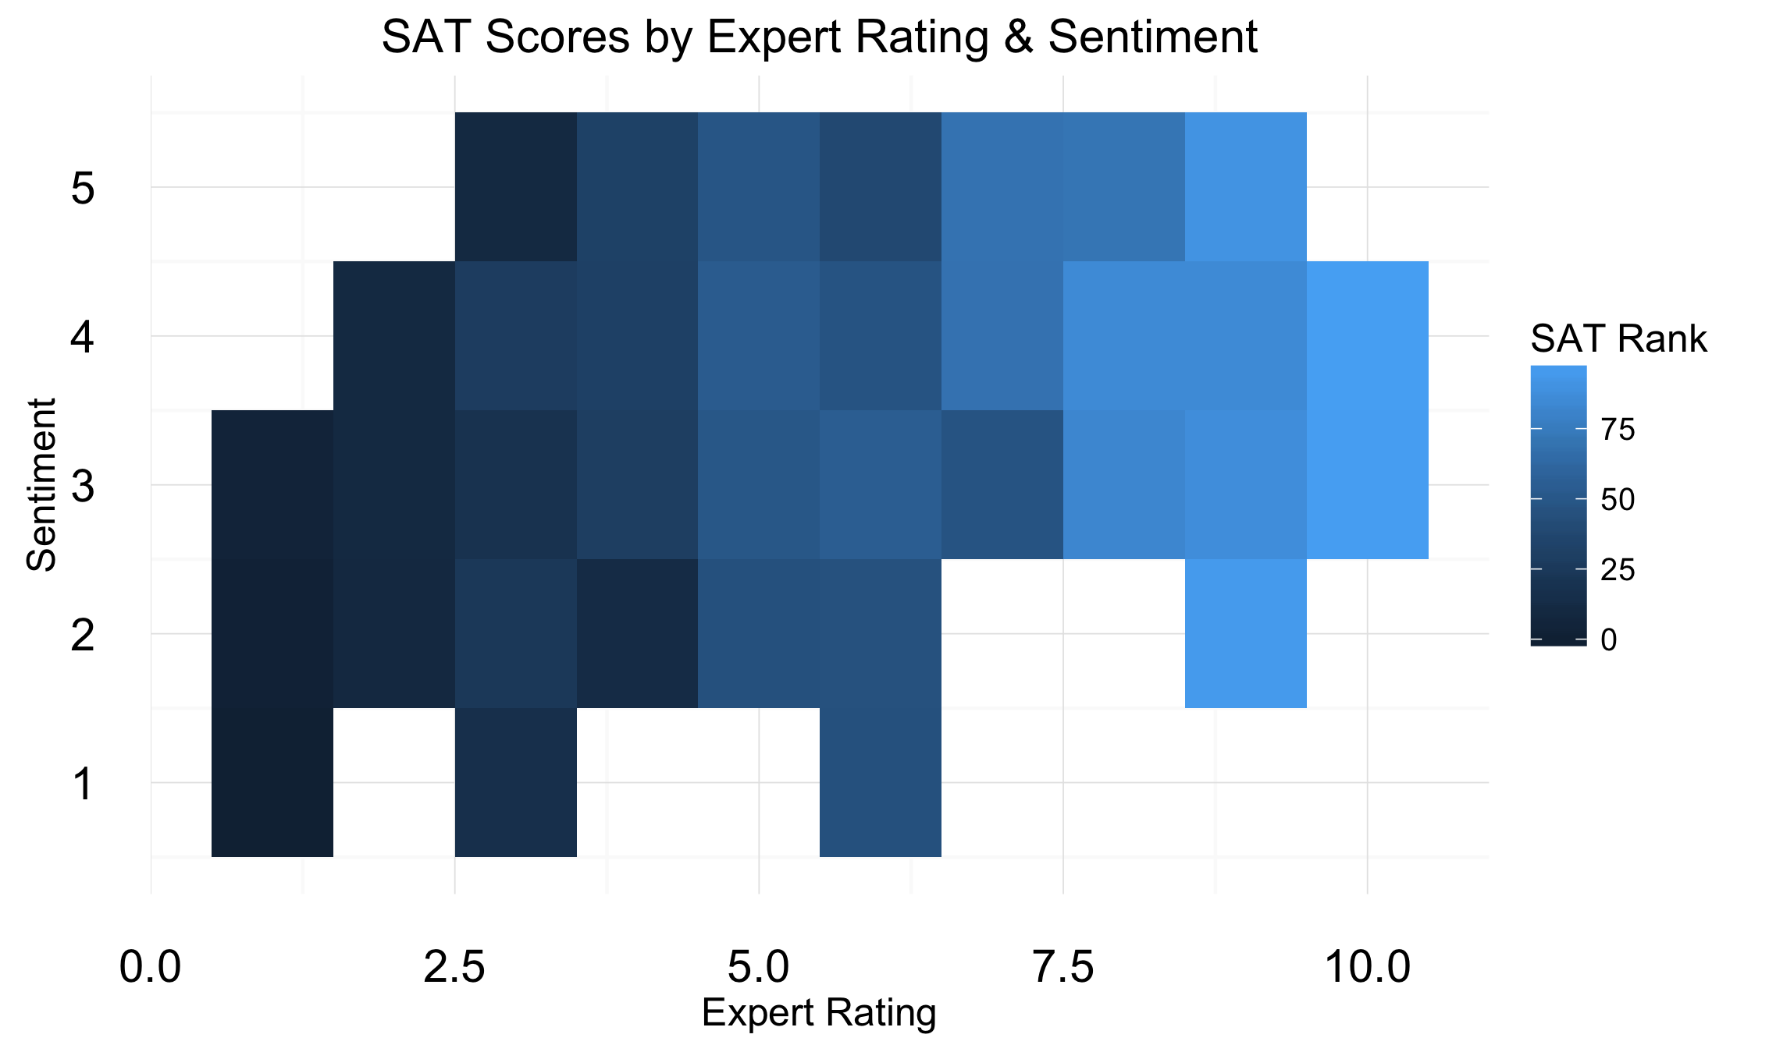
User Ratings Less Related to Measurable Outcomes
Few schools with low sentiment and high scores

Slide 8
Part 2
Can we use natural language processing (NLP) to measure reviews?

Slide 9
Missingness an Issue in User Ratings
Stars | Review
 | The teachers at RHS are engaged and effective. As an Alumni of the program I feel my time at the school prepared me for college.
 | My son is going into his Junior year at MCST, and I am so very grateful that we found this ideal environment.
(none) | I give MHS zero stars. MHS is not a place to learn and grow, but an institution that only cares and caters to the overachieving and overprivileged.
(none) | My children (one currently a junior, the other a college freshman) received an excellent education at this school. The breadth of courses is impressive.
Average rating is 4 but implied rating is 3!
Data has both MCAR and MNAR issues

Slide 10
Solution: Impute through NLP
Tidy Text Lexicons
Unigram (one word)
Used Bing and NRC lexicons
Averaged word sentiments to derive Comment sentiment
Naïve Bayes
Split star rating metric to positive/negative for training
2-fold cross-validation
NRC Word-Emotion Association Lexicon: crowd-sourced list of English words and their associations with eight basic emotions and two sentiments.
Bing: binary pos/negative sentiment lexicon developed by Bing Liu

Slide 11
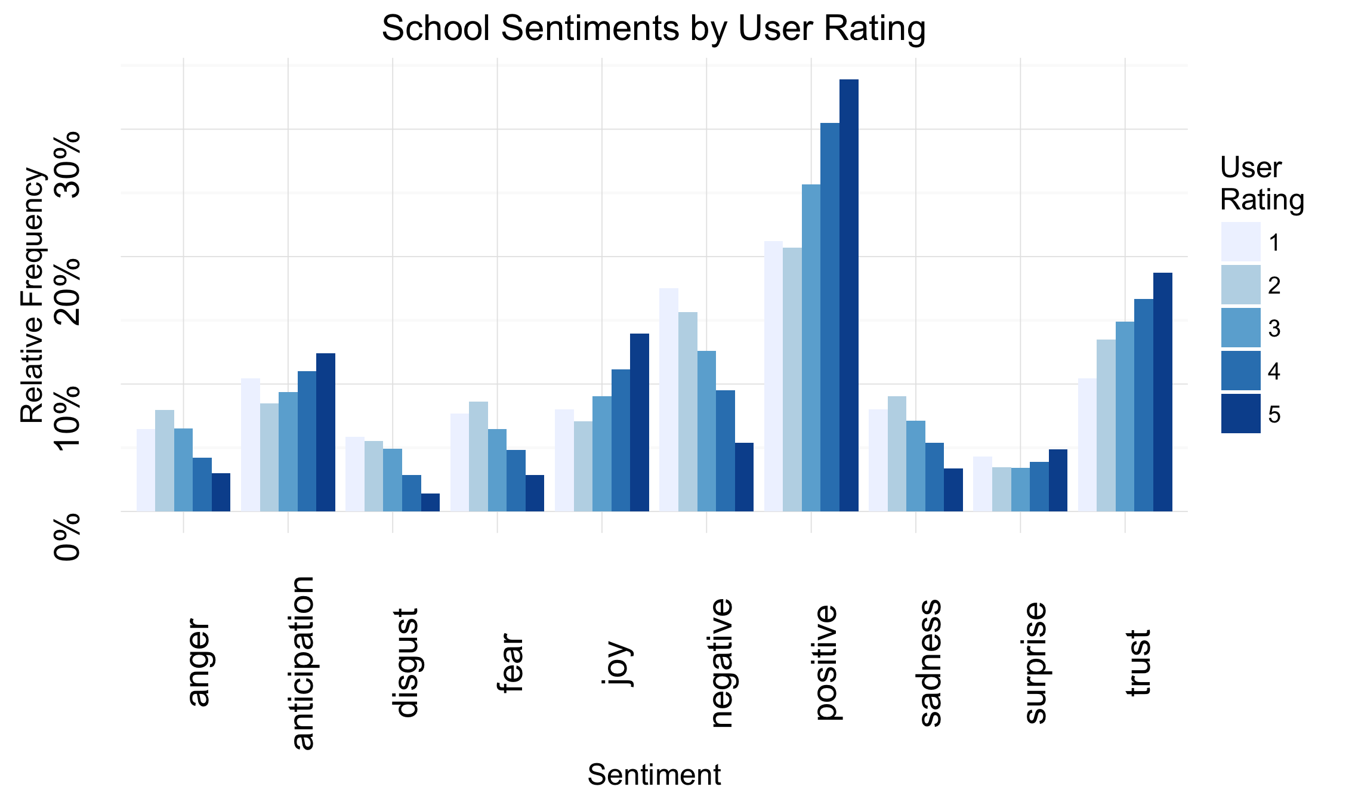
Tidy Text: NRC Analysis
User ratings related to emotional content of comments

Slide 12
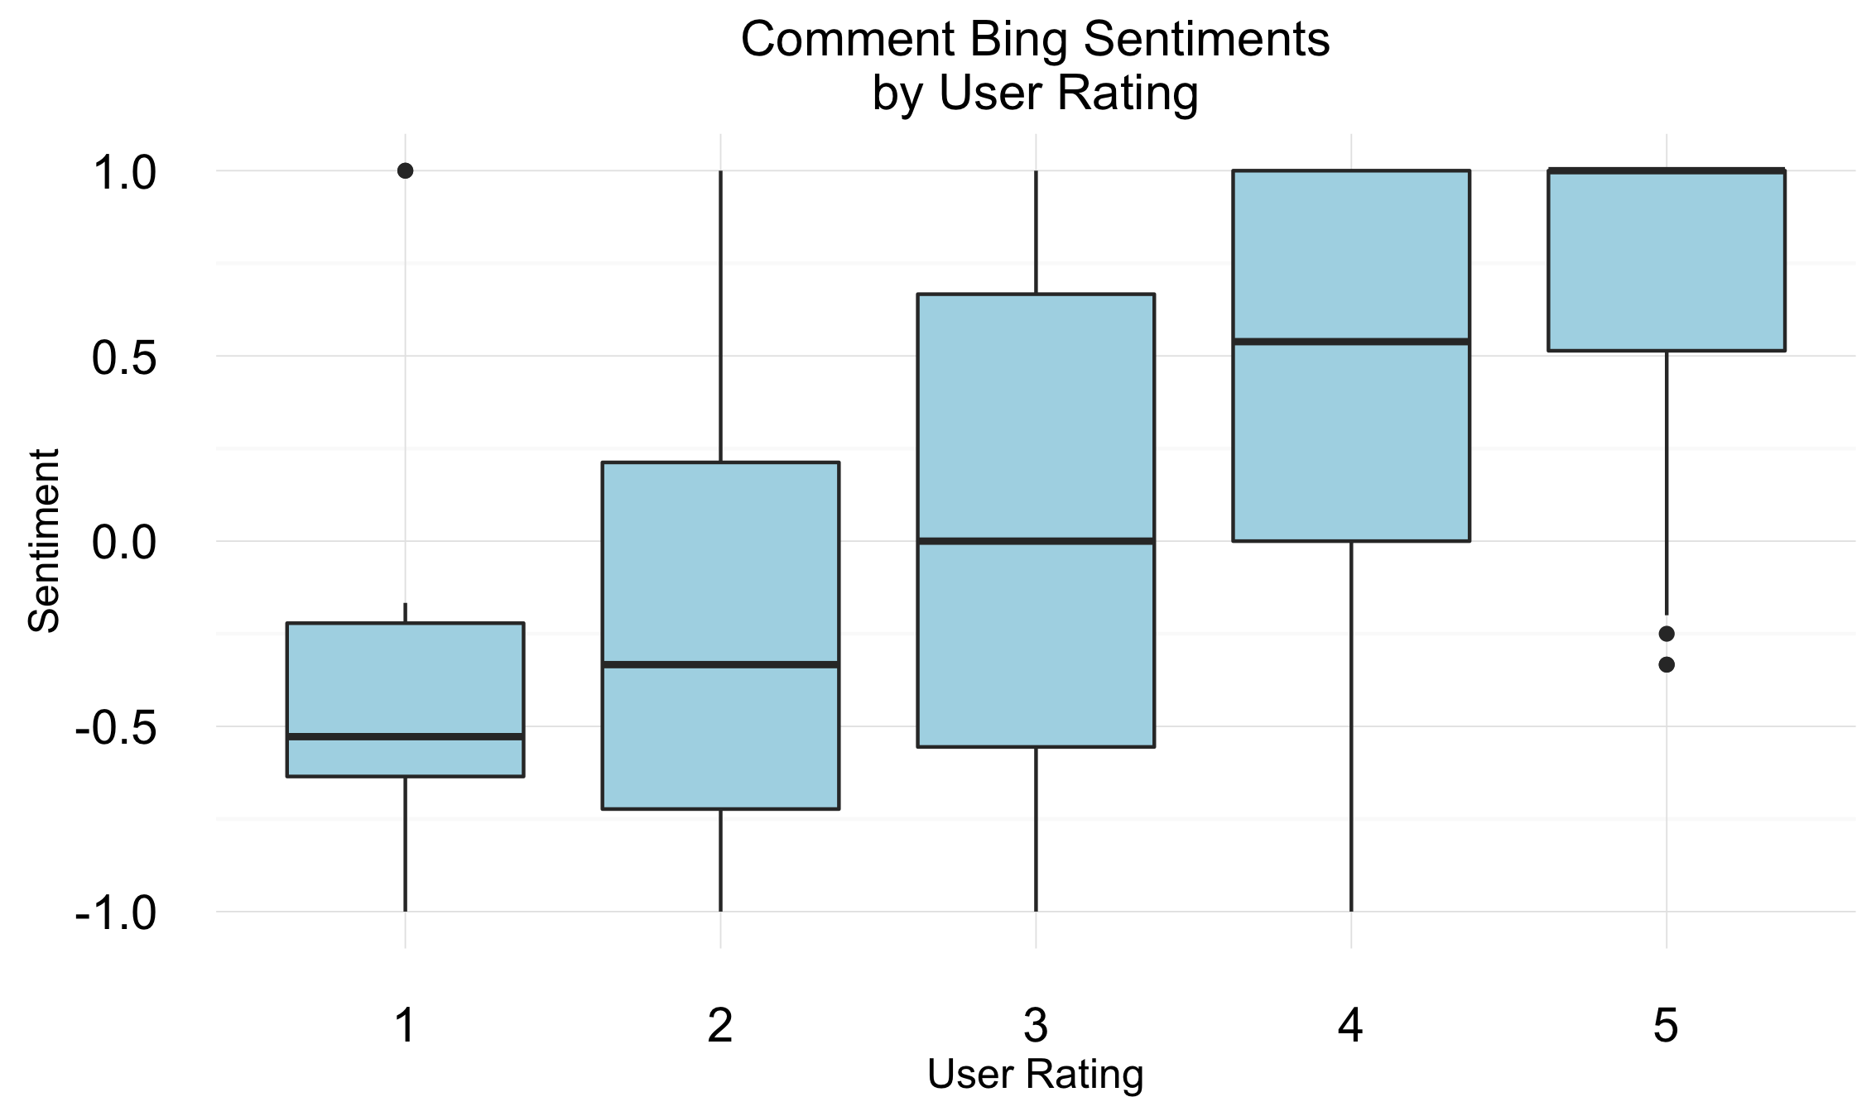
Tidy Text: Bing Sentiment
Statistically significant difference in means – candidate for imputing

Slide 13
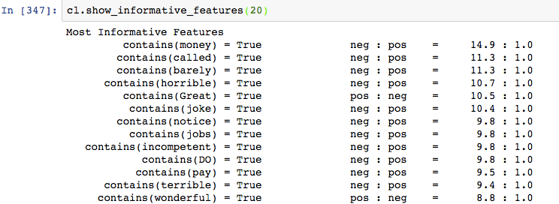
Naïve Bayes Imputation
 | Correct | Incorrect | Total
Positive | 504 | 124 | 626
Negative | 102 | 27 | 129
Total | 606 | 151 | 755
Sensitivity & Specificity: 80%

Slide 14
In Closing…
Summary
Loose connection between user rating and SAT scores, but…
Avoid schools with very low user ratings if SAT scores are important to you
User reviews may add useful color beyond basic metrics already captured by the state
Next Steps
More cross-validation
Comparison of Bing vs Naïve Bayes imputations
More statistical analysis

